Slide 1

Students testing application
Student:
Hundarchuk Vladyslav
Kyiv-2021

Slide 2









Used tools
- for store backend and frontend.
- for hosting servers.
- for creating servers in the cloud and configure securing groups.
- for run microservice architecture.
- for CI/CD.
- for store users and tests password and data.
- for creating site’s frontend and connecting API to him.
- for remote configuring servers.
- for creating backend API’s.

Slide 3
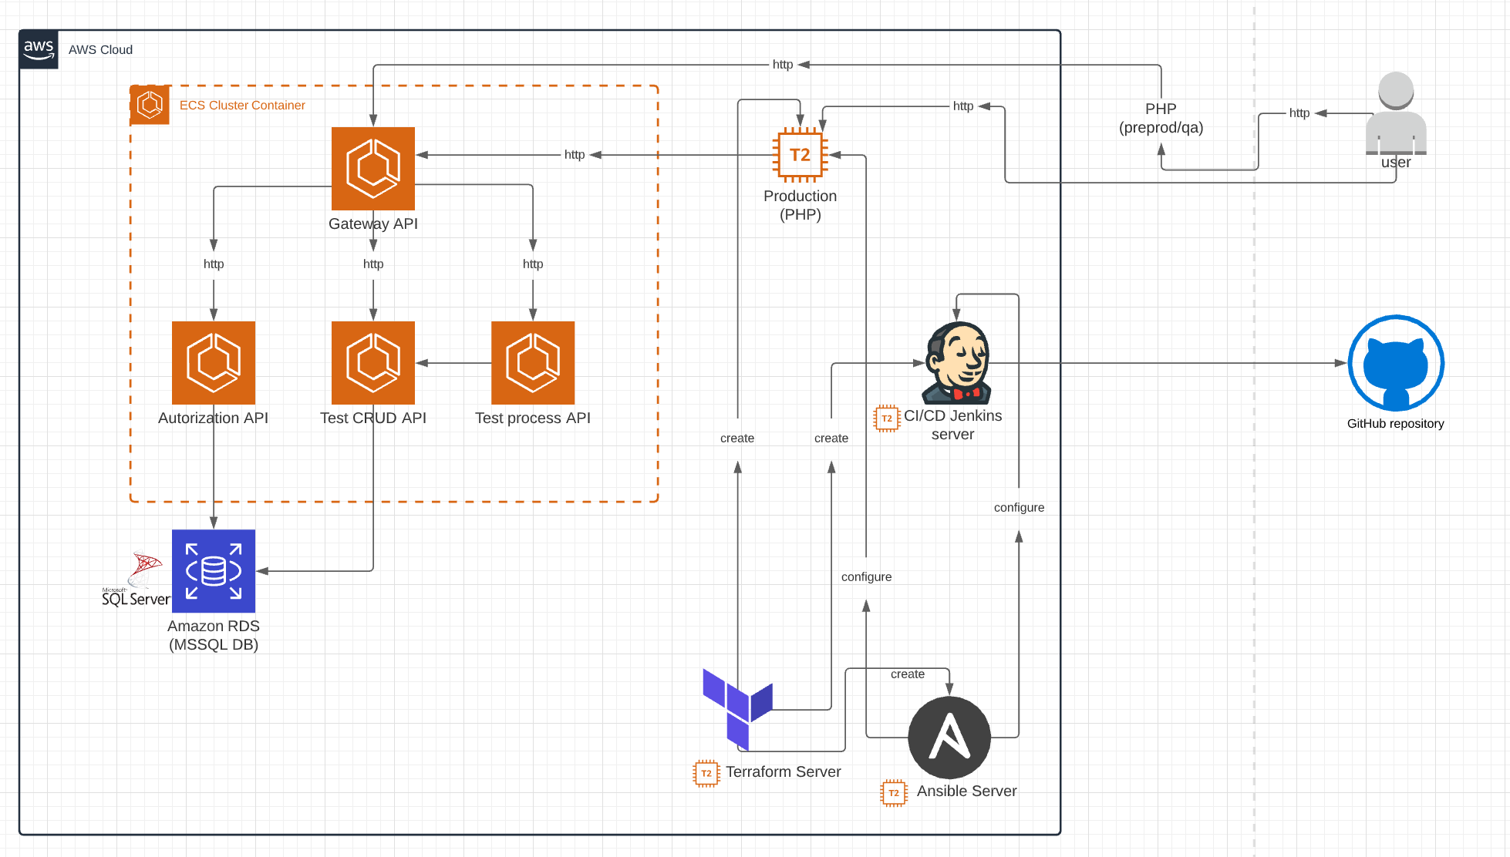
Project infrastructure

Slide 4

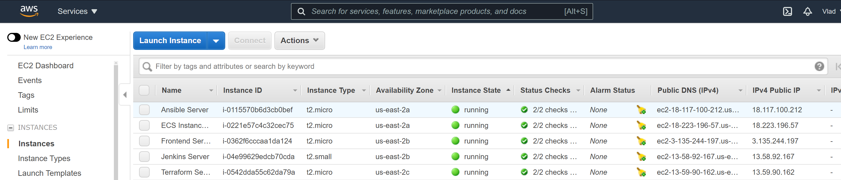
Instances
Ansible Server – server for configure other servers.
Jenkins Server – server for CI/CD and Jenkins.
Frontend Server – server for host the frontend(using nginx).
ECS Server – microservice cluster instance.
Terraform Server – server for creating other instances.

Slide 5

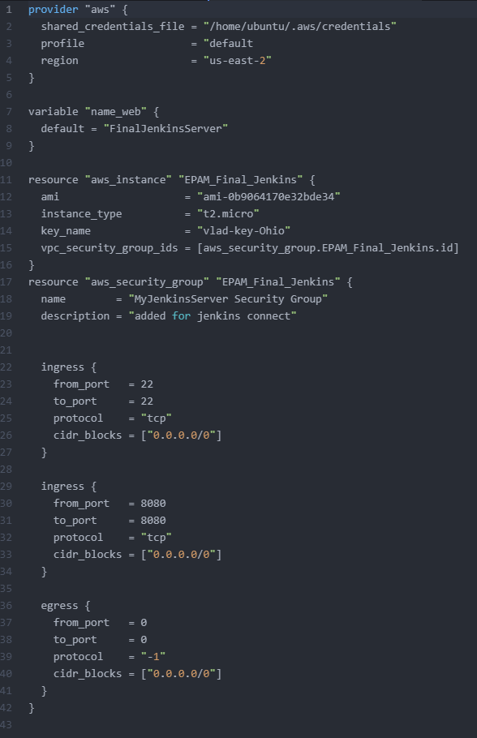
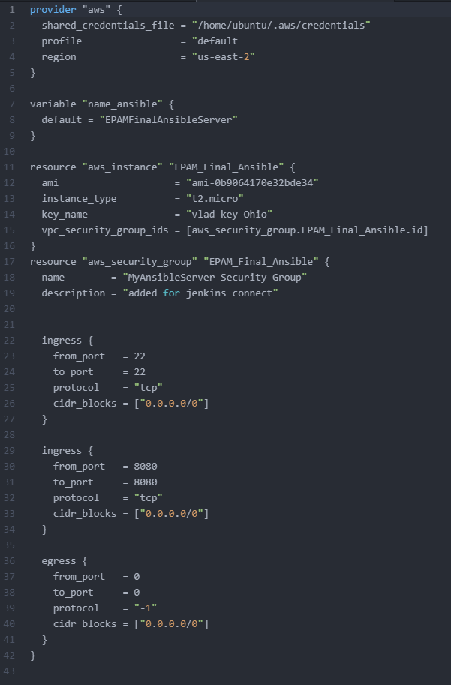
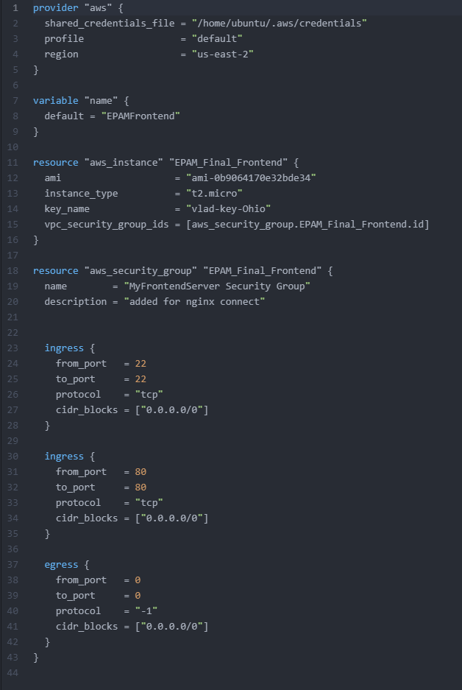
Terraform
Jenkins Server:
Ansible Server:
Frontend Server:

Slide 6

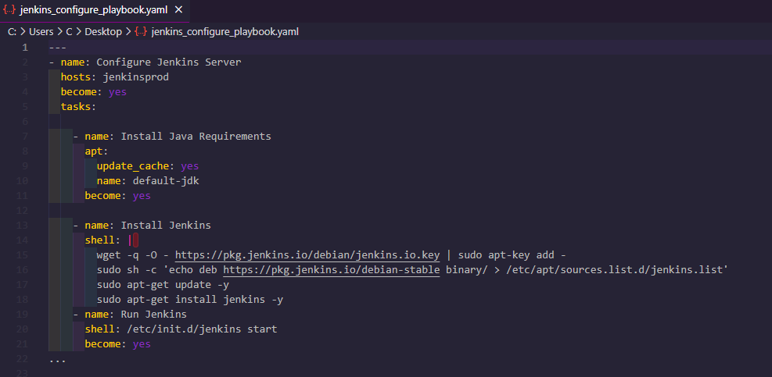
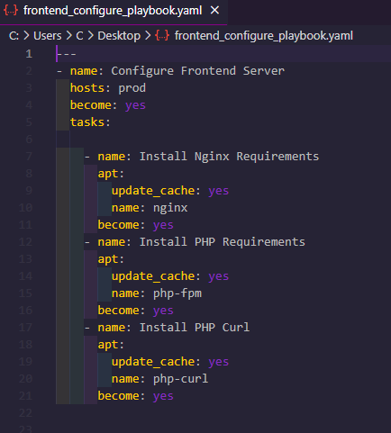
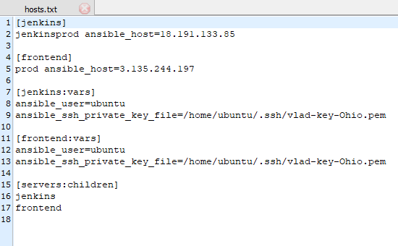
Ansible
Configure Frontend Server:
Configure Jenkins Server:
Hosts file:

Slide 7

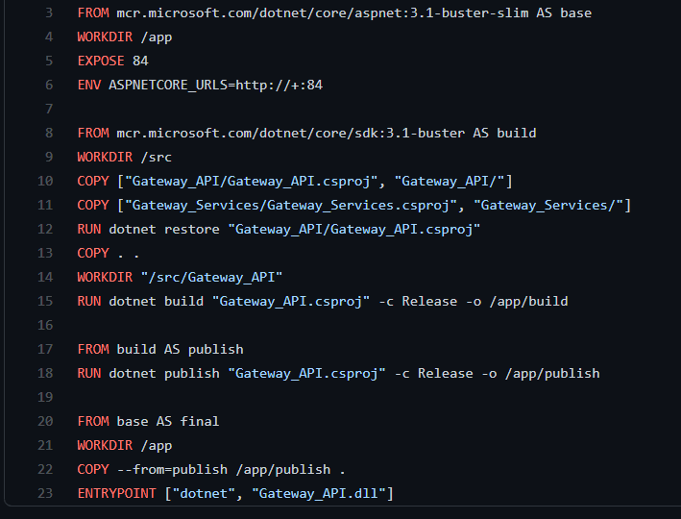
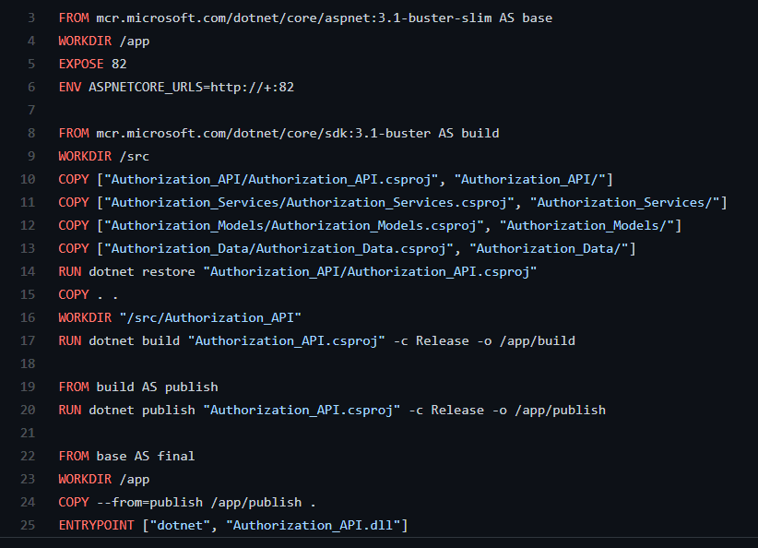
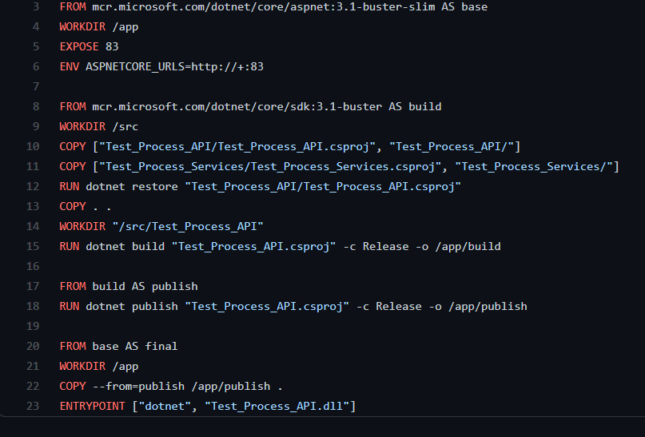
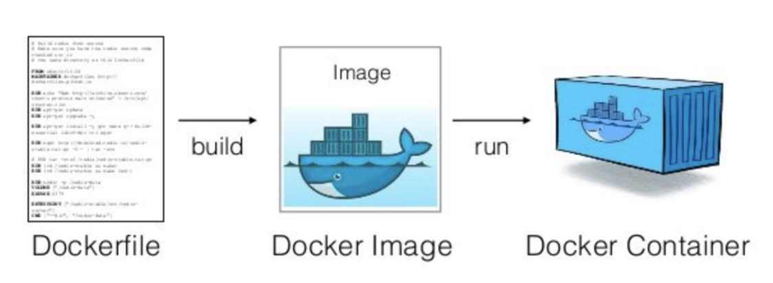
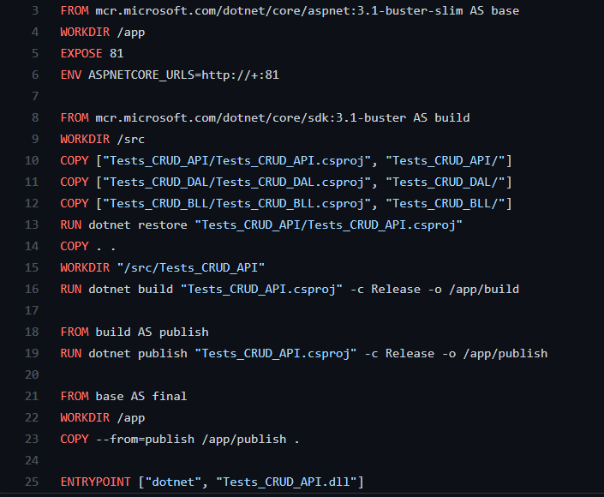
Amazon ECR Dockerfiles (Elastic Container Registry)
Gateway API Dockerfile:
Authorization API Dockerfile:
Process API Dockerfile:
CRUD API Dockerfile:

Slide 8

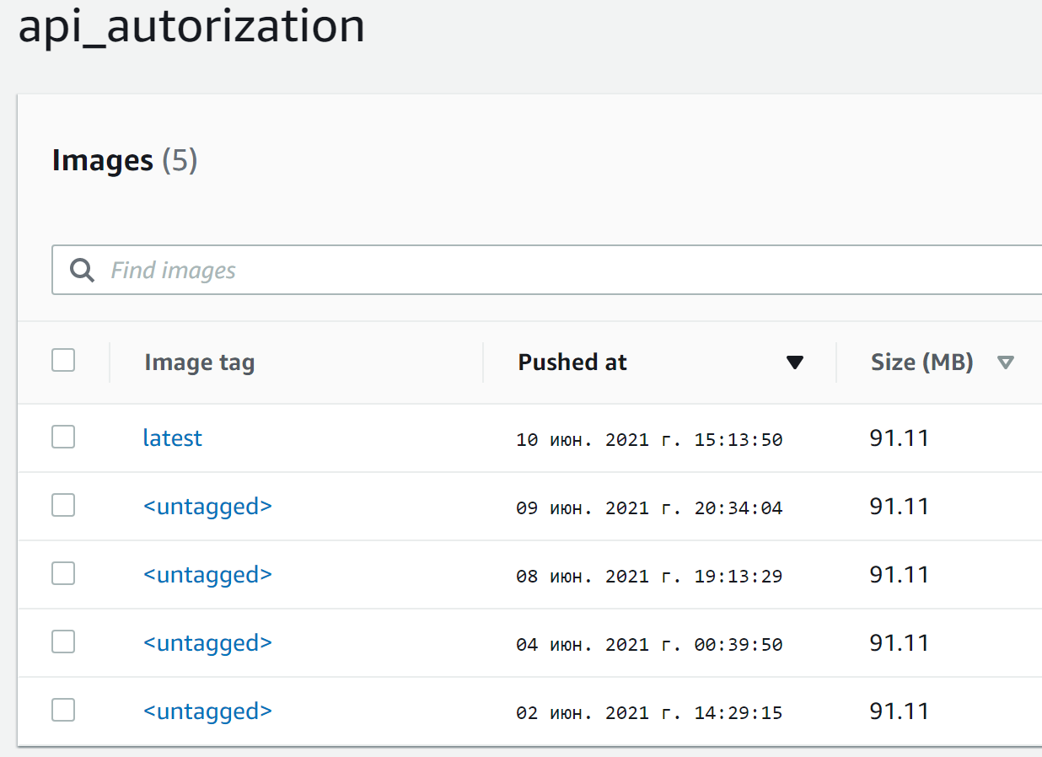
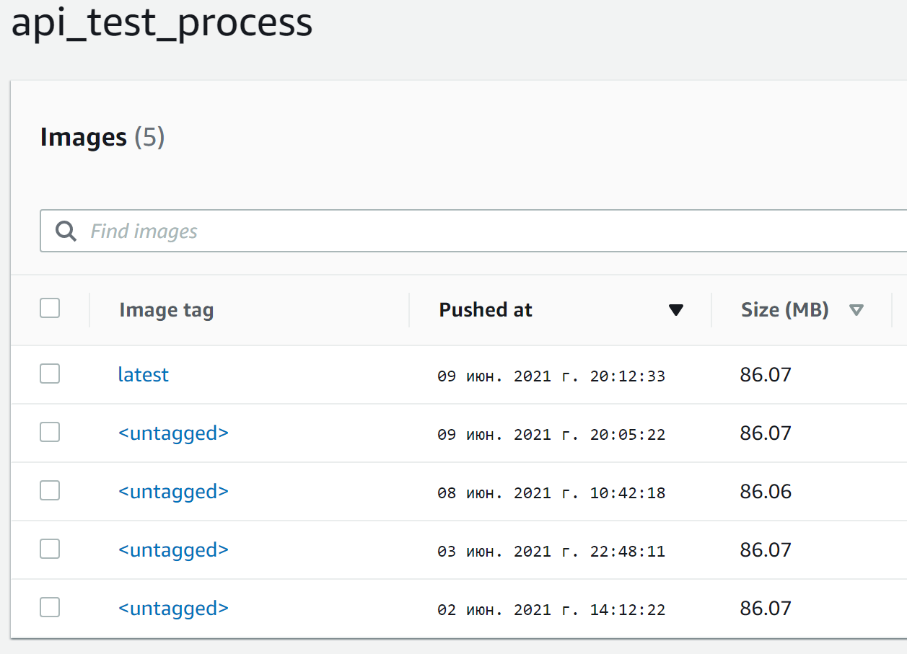

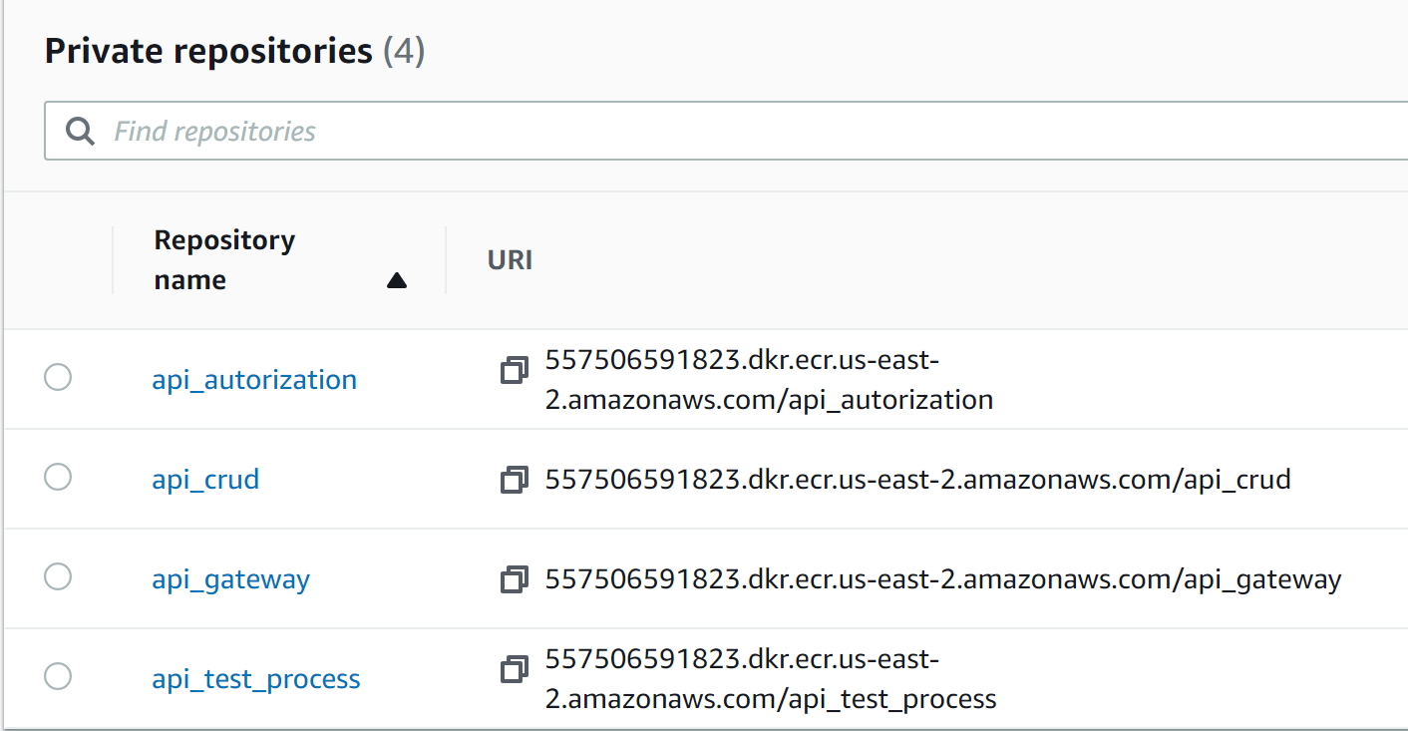
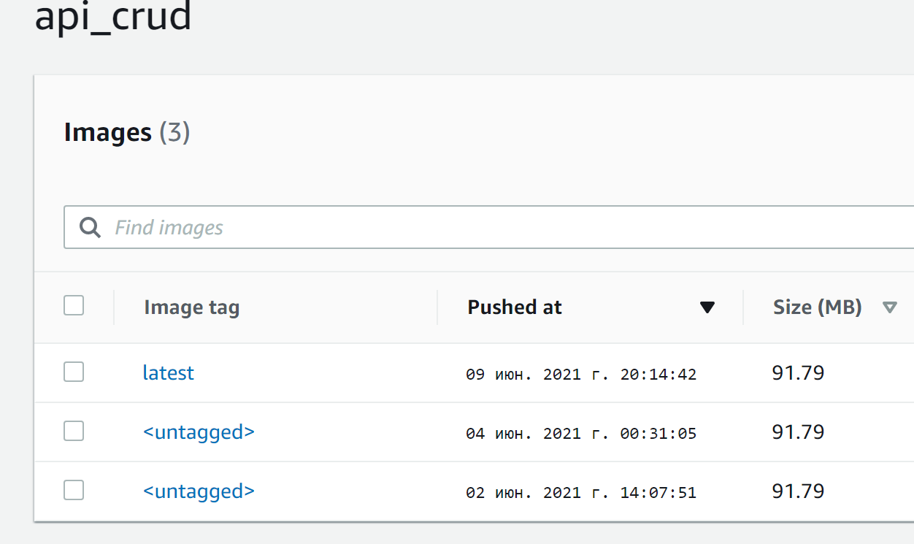
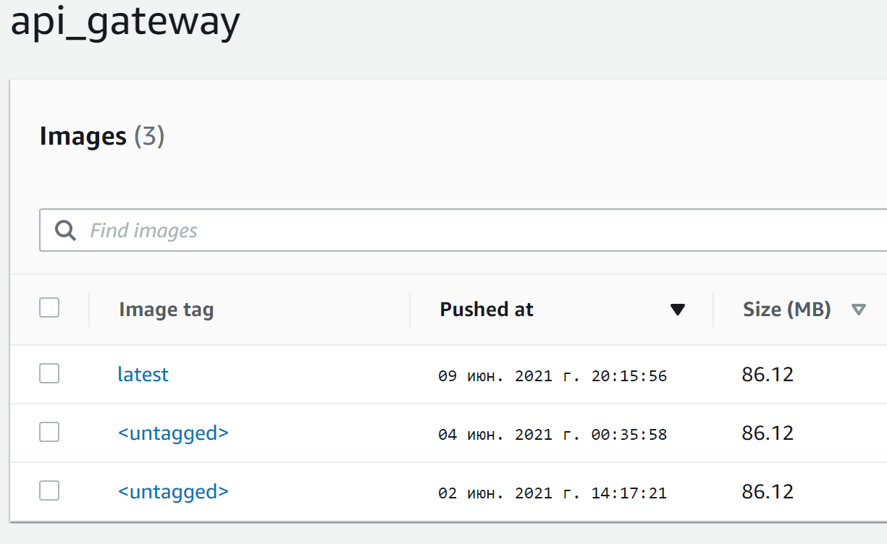
ECR Repositories
Authorization API builds:
Test Process API builds:
Repositories:
CRUD API builds:
Gateway API builds:

Slide 9

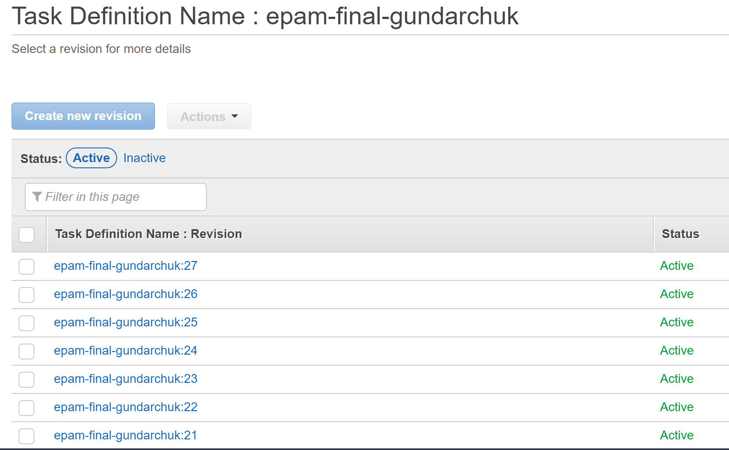
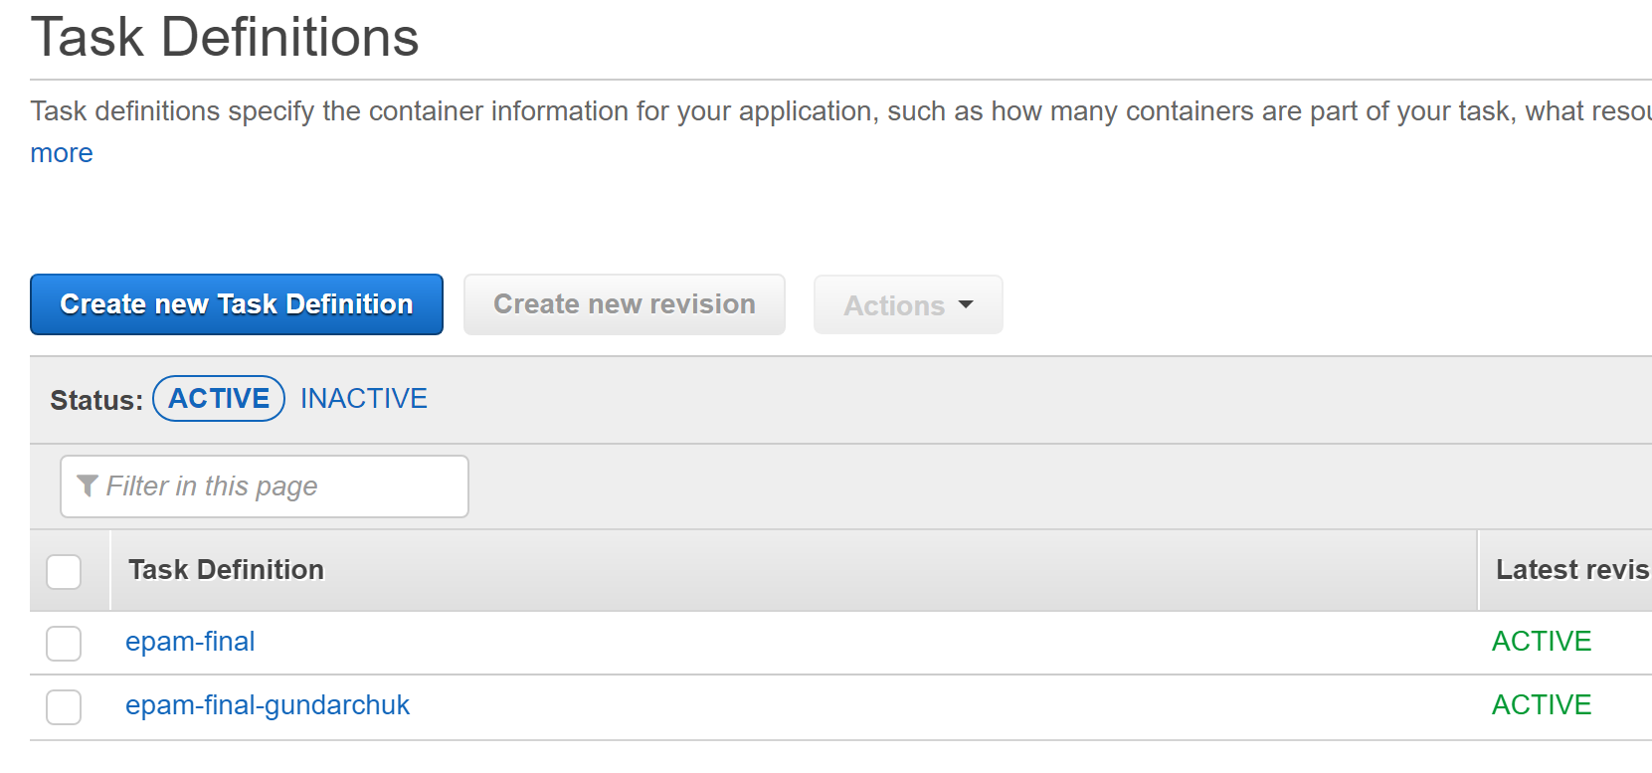
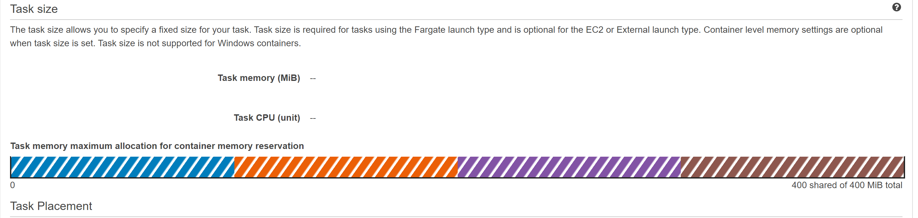
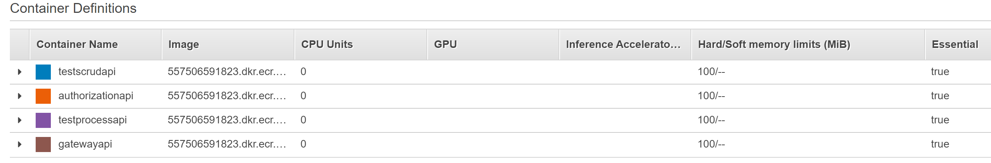
ECS Task definitions
Task definition revisions ( Jenkins CD create new revision):
Task definitions:
Load Balancer:
Containers inside task definition:

Slide 10
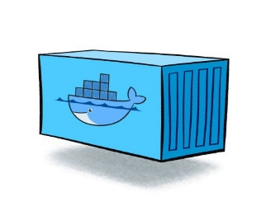
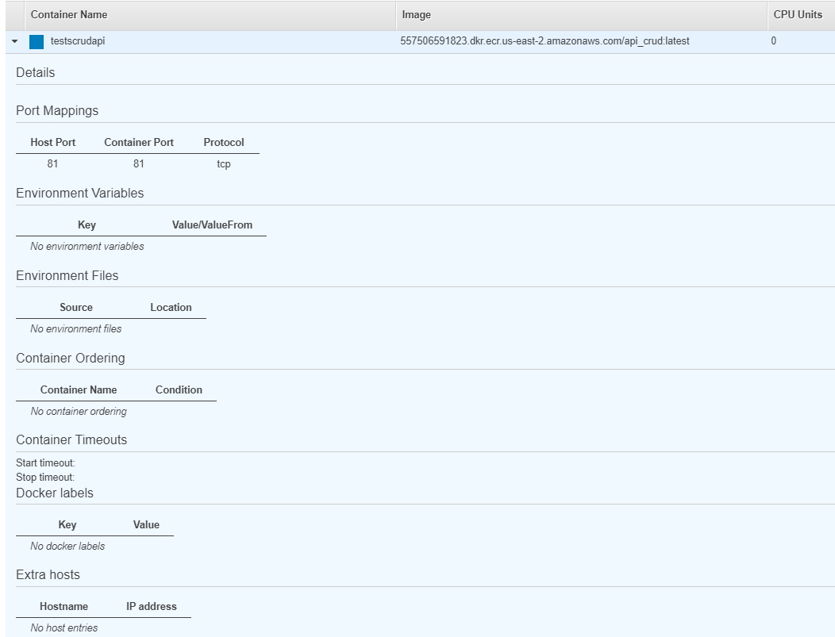
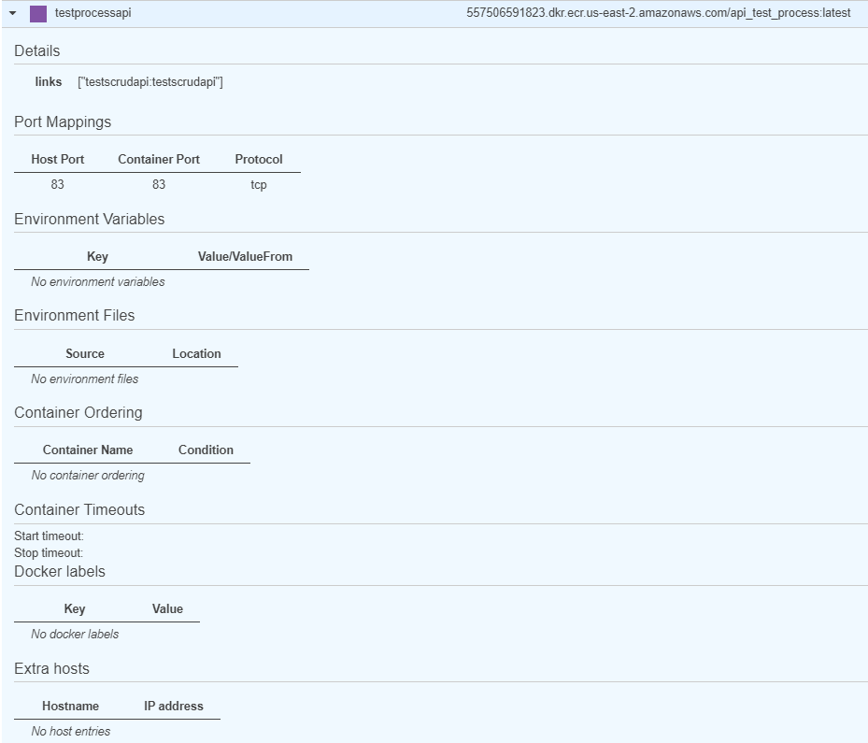
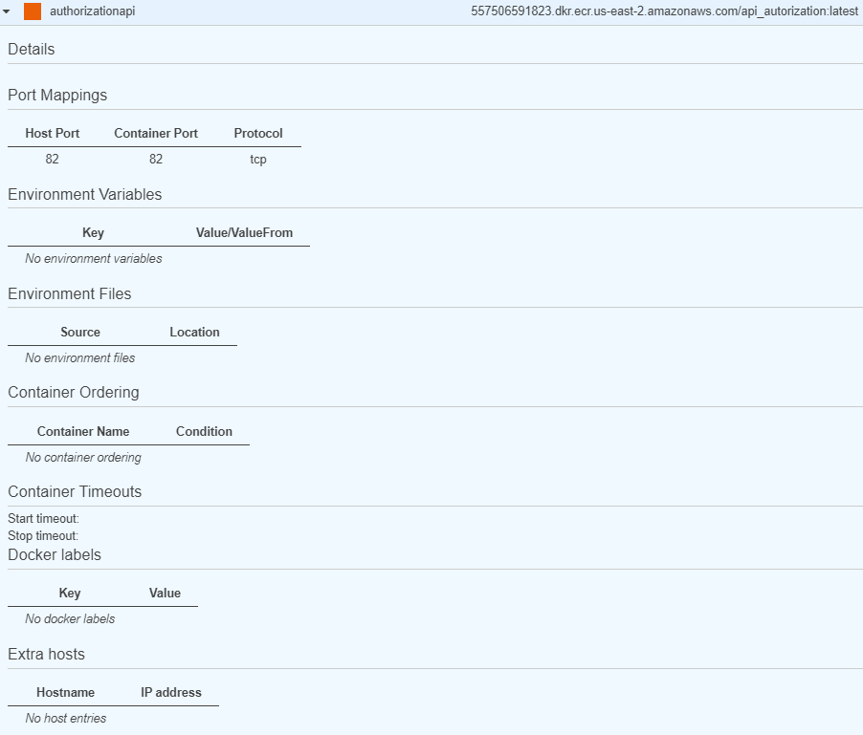
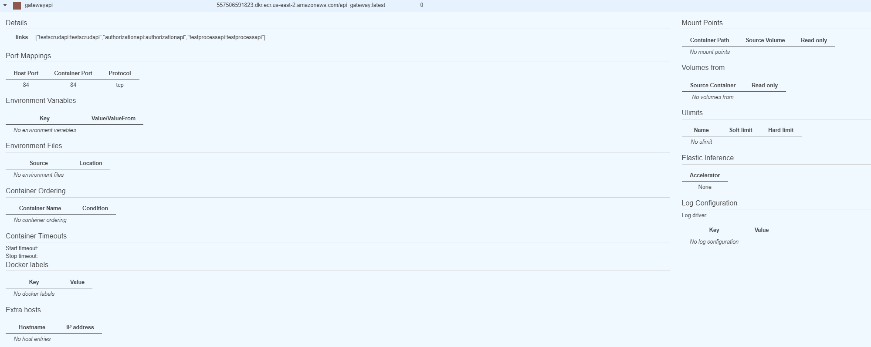
Task Containers
Crud API container:
Test Process API container:
Authorization API container:
Gateway API container:

Slide 11
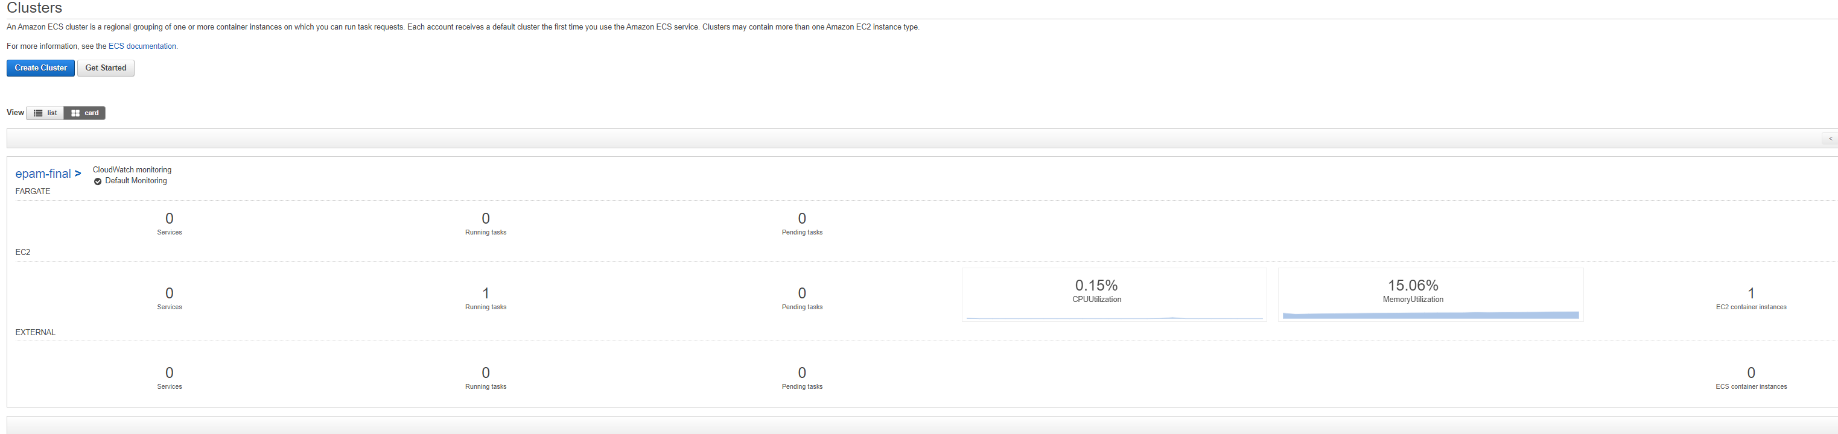
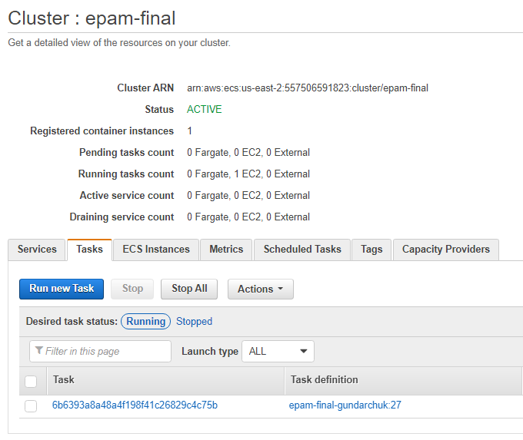
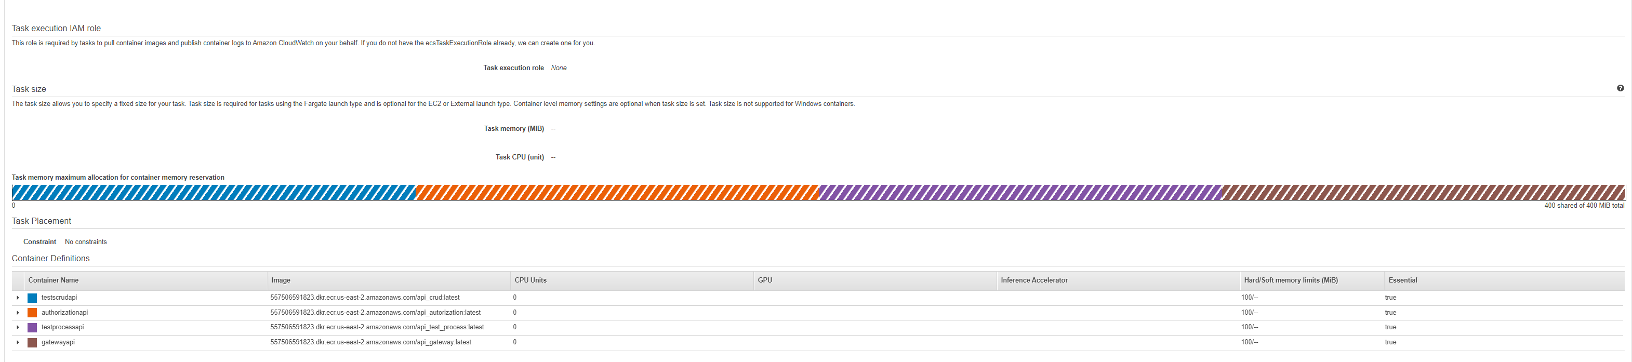
ECS Cluster
Cluster:
Cluster task:
Inside task:

Slide 12

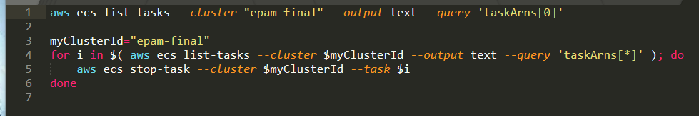
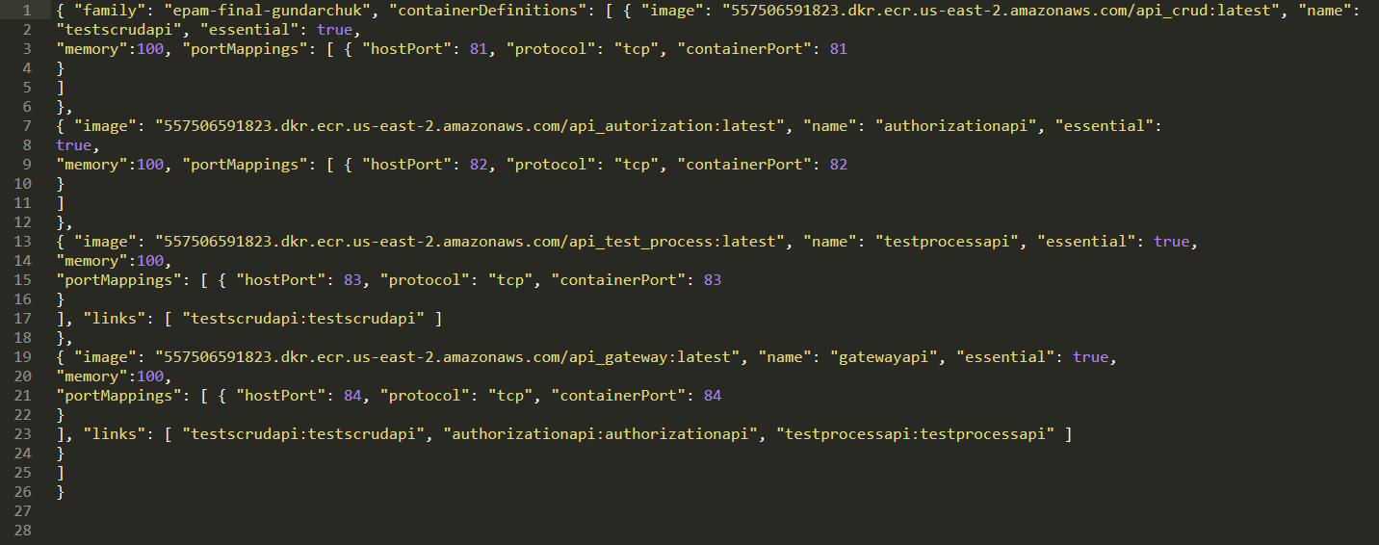
Jenkins scripts
Script for remove task definition from cluster:
Definition of containers in task definition:

Slide 13

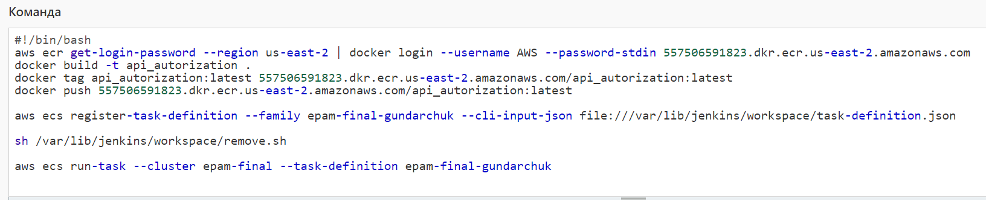
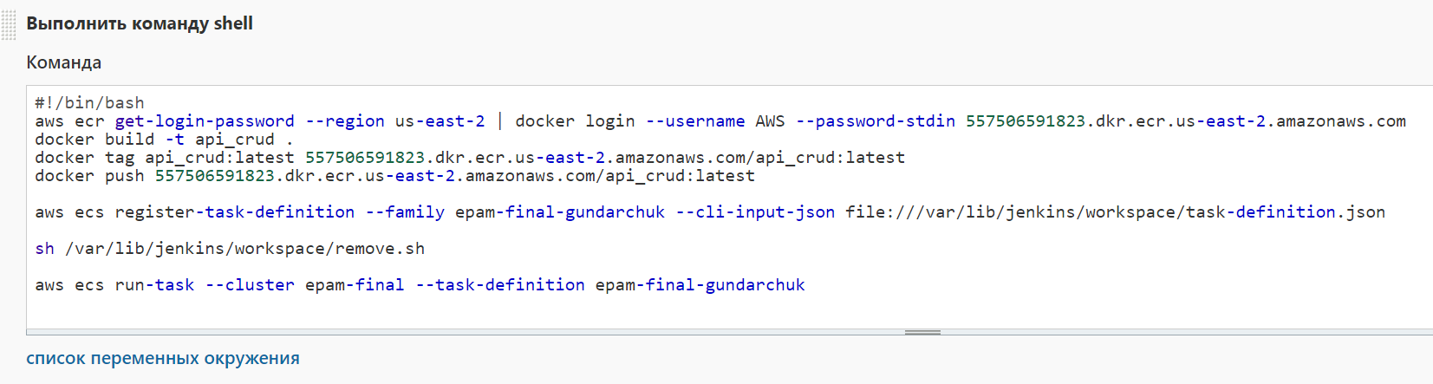
Jenkins Jobs (Path one)
Authorization API CI/CD job:
CRUD API CI/CD job:

Slide 14
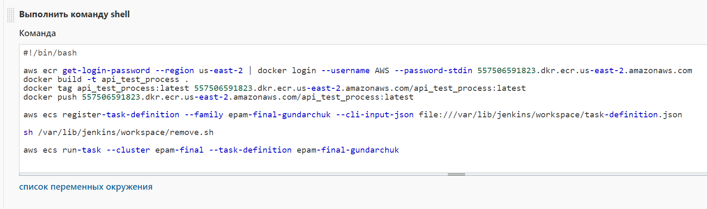
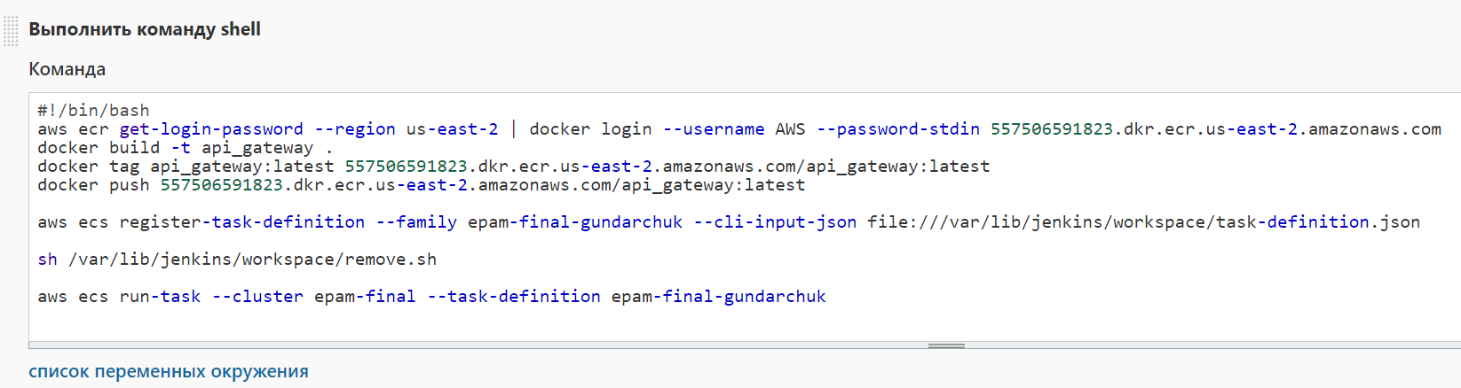
Jenkins Jobs (Path two)
Test Process API CI/CD job:
Gateway API CI/CD job:

Slide 15

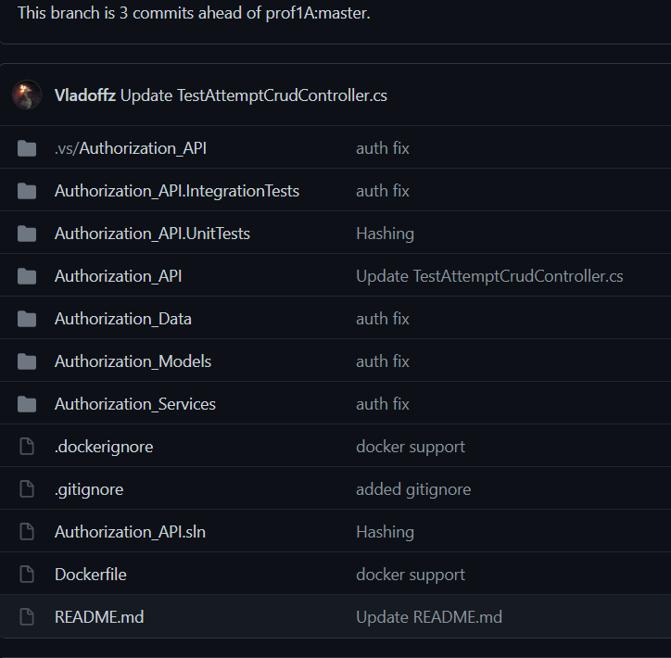
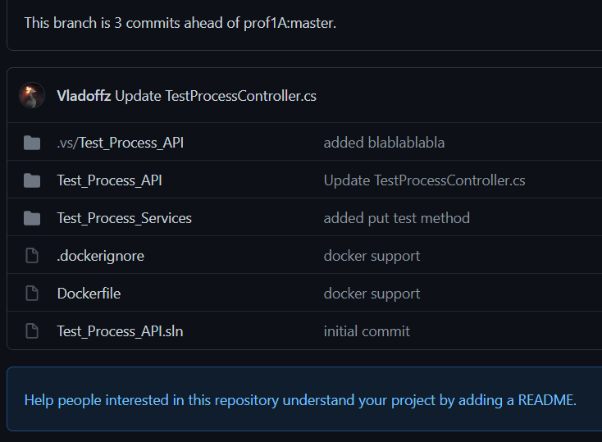
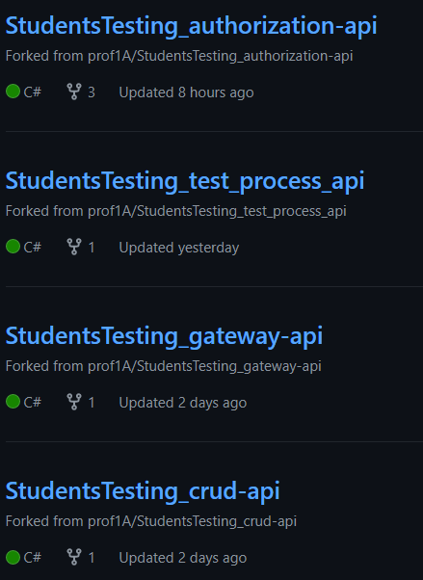
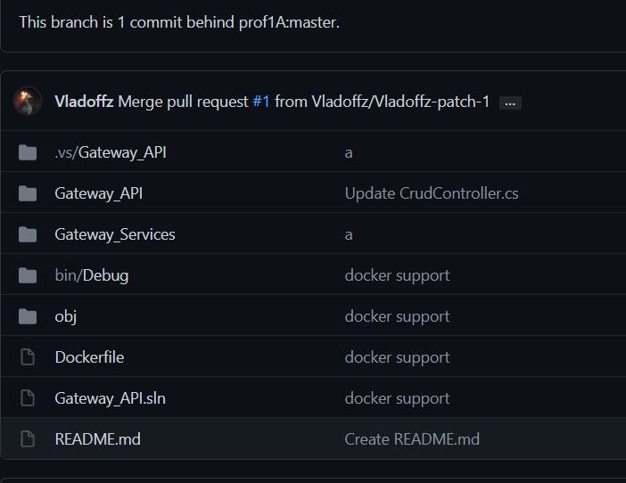
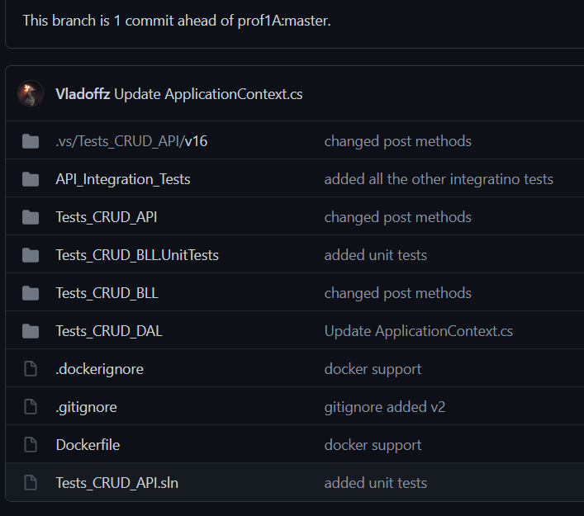
Github Repositories
Authorization API Repository:
Test Process API Repository:
Backend Repositories:
Gateway API Repository:
CRUD API Repository:

Slide 16

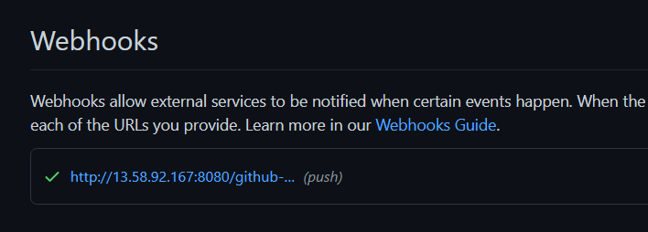
Github Webhooks for Jenkins
Authorization API Webhook:
Gateway API Webhook:
CRUD API Webhook:
Test Process API Webhook:

Slide 17


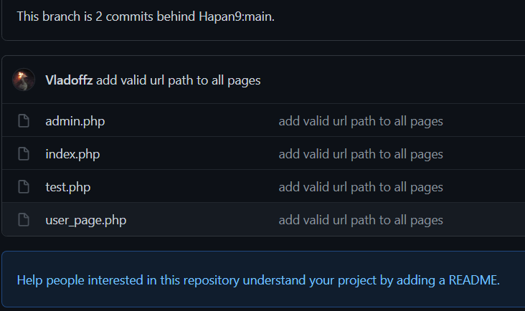

Frontend Server
Frontend GitHub repository:
Inside repository:

Slide 18
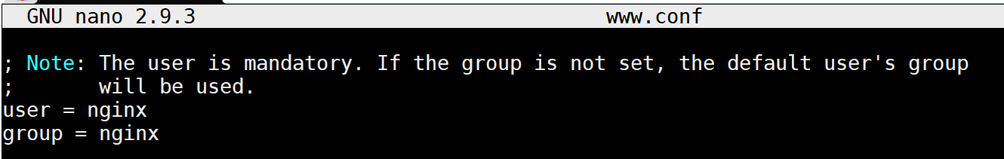
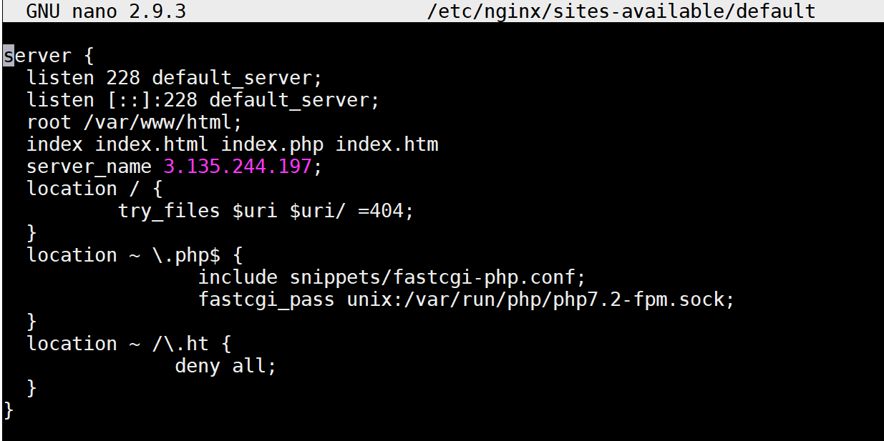
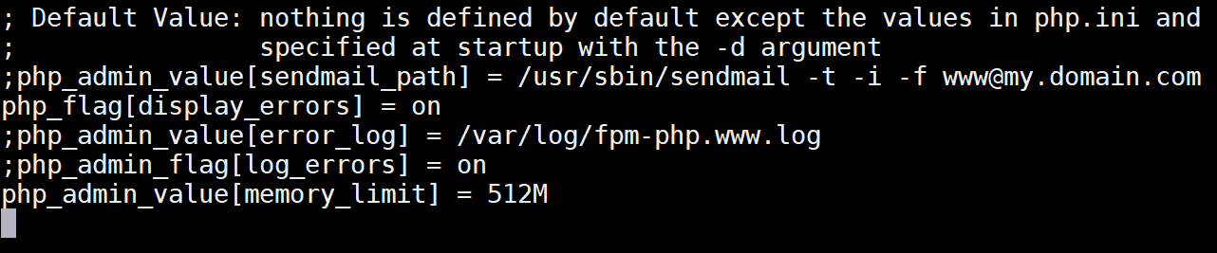
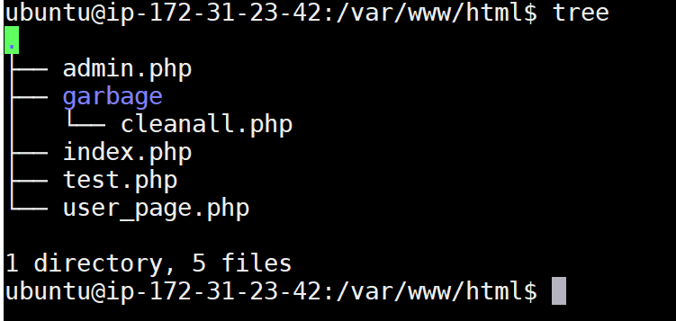
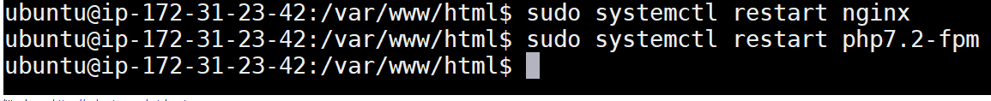
Configure Frontend Server for nginx:
Second step – configure www.conf in /etc/php/7.2/fpm/pool.d:
First step - configure default file:
Third step – copy files to /var/www/html:
Fourth step – restart nginx and php-fpm services:

Slide 19
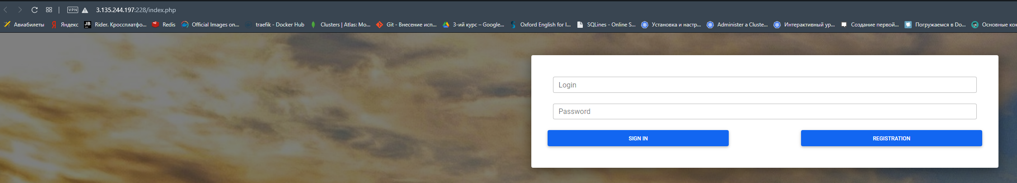
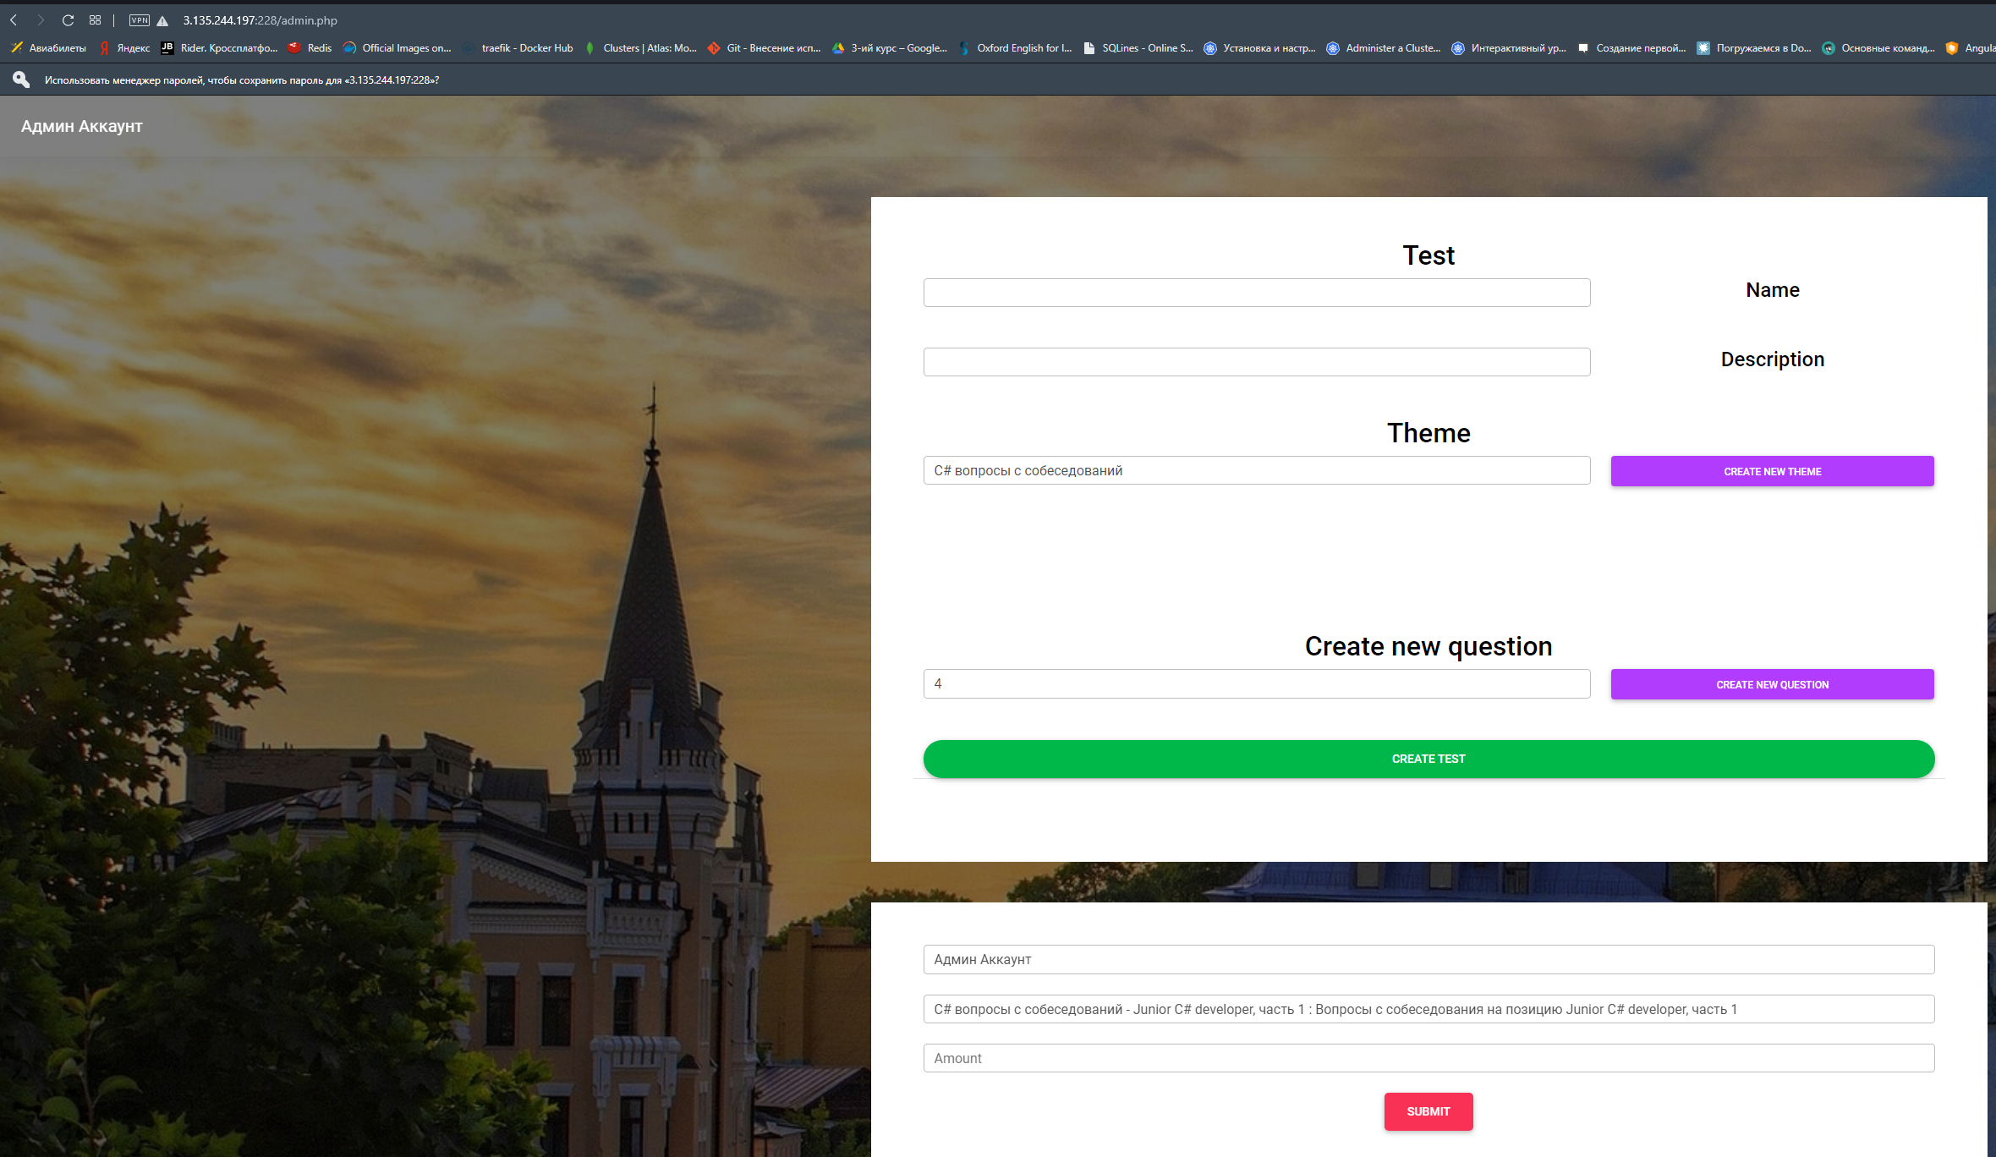
Work result (path one)
Main page:
Admin page:

Slide 20


Work result (path two)
User page with tests:
Tests page:

Slide 21






RDS Database (Microsoft SQL)
Database in SSMS:
CRUD database tables:
Admin database tables:
Database in AWS RDS:
User database tables:

Slide 22


Swagger
Swagger for graphic documentation API:

Slide 23

Thanks for you attentions!
Project by Vlad Hundarchuk
Github: https://github.com/Vladoffz

